Slide 1
Number plate recognition for granting access to uwc
Compiled and Presented by KJ Tsiri
Supervisor : Mr. Ismail

Slide 2
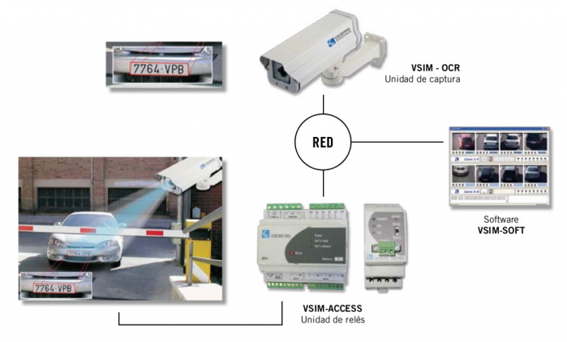
recap
To build a system that will use number plate to identify vehicle.
Why, It makes it easier to recognize a vehicle?

Slide 3
South African legal number plates sizes
520 mm x 113 mm - Only 75mm letter size (font) may be used
250 mm x 205 mm - Only 75mm letter size (font) may be used
250 mm x 165 mm – Only 60mm letter size (font) may be used
440 x 120mm size number plate

Slide 4
Number plate ratio
0.2173076923 0.15 : 0.3
0.82 0.7 : 0.9
0.66 0.6 : 0.7
0.2727272727;
Notes:
The black line represents the equality of ratios.

Slide 5
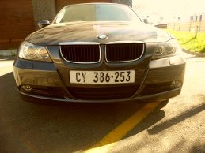
implementation
Input image

Slide 6
Implementation cont(processes involved)
Grayscale image
Histogram Equalization

Slide 7
Implementation cont……….
Binarization
Edge detection

Slide 8
Implementation cont…………
Morphological functions (Erosion and dilation)
Finding the boundary box and extracting the plate

Slide 9
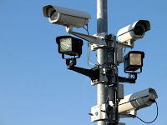
Tools used
Linux Operating System
Java programming language
Kate editor and Linux terminal
Camera

Slide 10
testing
Functionality testing

Slide 11
Functionality testing
Unit Testing
Integration Testing
System Testing

Slide 12
Functionality testing
The system is suppose to recognize plate in different weather conditions.
Sunset
When it is raining
Or when it is cold

Slide 13
Functionality testing

Slide 14
System Testing
Input
Output

Slide 15
REFERENCES
[1] Vahid Abolghasemi, Alireza Ahmadyfard, “An edge-based color-aided method for license plate detection”, Elsevier, Image and Vision Computing , 27 (2009) 1134–1142.
[2] Nicole Ketelaars Italy. (2001). “Automated License Plate Recognition”. AIMe Magazine 2002/1, pp. 9-12
[3] Pei Li “Number plate Recognition ”
[4] J. Matas and K. Zimmermann. Unconstrained licence plate and text localization and recognition. In IEEE Proceeding on Intelligent T ransportation Systems, pp. 225 – 230, 2005.
[5] Christos Nikolaos E. Anagnostopoulos, Ioannis E. Anagnostopoulos, Vassili Loumos and Eleftherios Kayafas, “A License Plate-Recognition Algorithm for Intelligent Transportation System
[6] P. Wu, H.-H. Chen, R.-J. Wu, and D.-F. Shen. License plate extraction in low resolution video. In 18th International Conference on Pattern Recognition, 2006.

Slide 16
demo
Start demo

